Slide 1
Chapter 18: Database System Architectures
Centralized Systems
Client--Server Systems
Parallel Systems
Distributed Systems
Network Types

Slide 2
Centralized Systems
Run on a single computer system and do not interact with other computer systems.
General-purpose computer system: one to a few CPUs and a number of device controllers that are connected through a common bus that provides access to shared memory.
Single-user system (e.g., personal computer or workstation): desk-top unit, single user, usually has only one CPU and one or two hard disks; the OS may support only one user.
Multi-user system: more disks, more memory, multiple CPUs, and a multi-user OS. Serve a large number of users who are connected to the system vie terminals. Often called server systems.

Slide 3
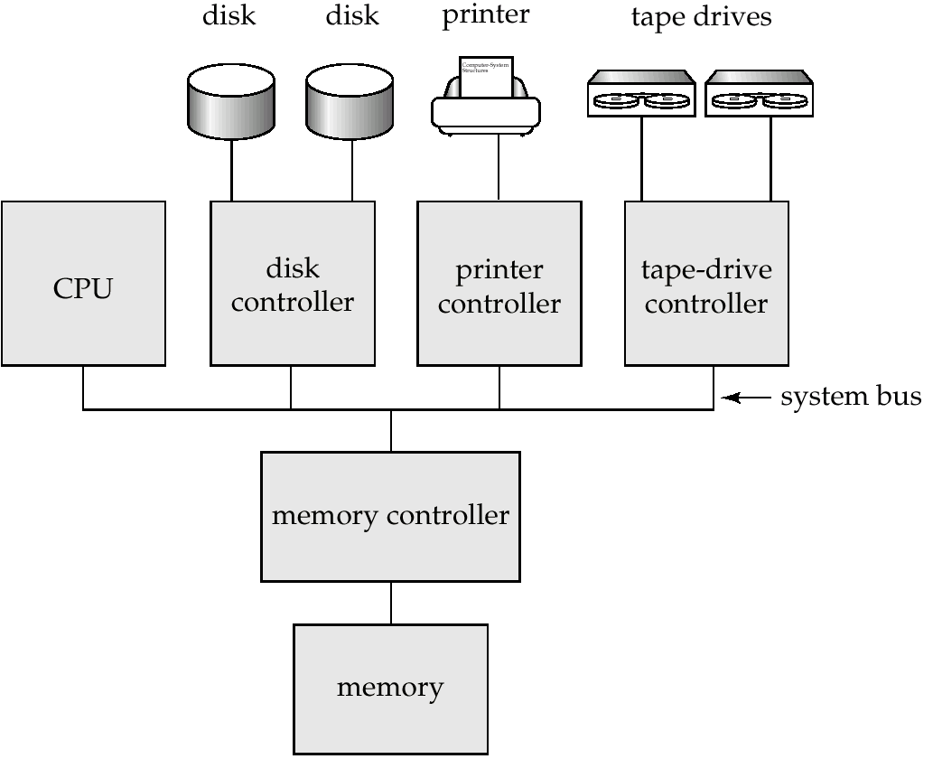
A Centralized Computer System

Slide 4
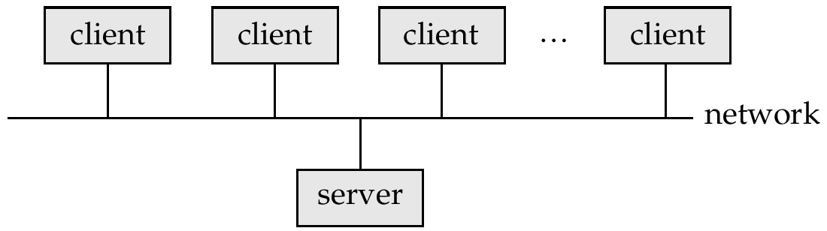
Client-Server Systems
Server systems satisfy requests generated at m client systems, whose general structure is shown below:

Slide 5
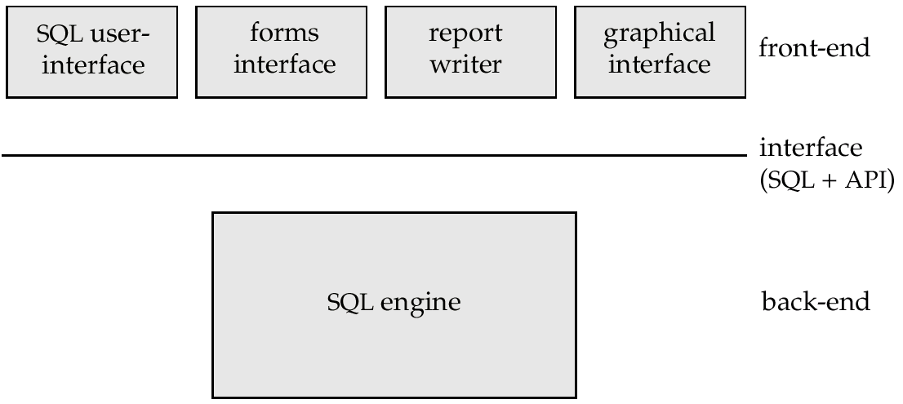
Client-Server Systems (Cont.)
Database functionality can be divided into:
  Back-end: manages access structures, query evaluation and optimization, concurrency control and recovery.
  Front-end: consists of tools such as forms, report-writers, and graphical user interface facilities.
The interface between the front-end and the back-end is through SQL or through an application program interface.

Slide 6
Client-Server Systems (Cont.)
Advantages of replacing mainframes with networks of workstations or personal computers connected to back-end server machines:
  better functionality for the cost
  flexibility in locating resources and expanding facilities
  better user interfaces
  easier maintenance
Server systems can be broadly categorized into two kinds:
  transaction servers which are widely used in relational database systems, and
  data servers, used in object-oriented database systems

Slide 7
Transaction Servers
Also called query server systems or SQL server systems; clients send requests to the server system where the transactions are executed, and results are shipped back to the client.
Requests specified in SQL, and communicated to the server through a remote procedure call (RPC) mechanism.
Transactional RPC allows many RPC calls to collectively form a transaction.
Open Database Connectivity (ODBC) is a C language application program interface standard from Microsoft for connecting to a server, sending SQL requests, and receiving results.
JDBC standard similar to ODBC, for Java

Slide 8
Transaction Server Process Structure
A typical transaction server consists of multiple processes accessing data in shared memory.
Server processes
  These receive user queries (transactions), execute them and send results back
  Processes may be multithreaded, allowing a single process to execute several user queries concurrently
  Typically multiple multithreaded server processes
Lock manager process
  More on this later
Database writer process
  Output modified buffer blocks to disks continually

Slide 9
Transaction Server Processes (Cont.)
Log writer process
  Server processes simply add log records to log record buffer
  Log writer process outputs log records to stable storage.
Checkpoint process
  Performs periodic checkpoints
Process monitor process
  Monitors other processes, and takes recovery actions if any of the other processes fail
    E.g. aborting any transactions being executed by a server process and restarting it

Slide 10
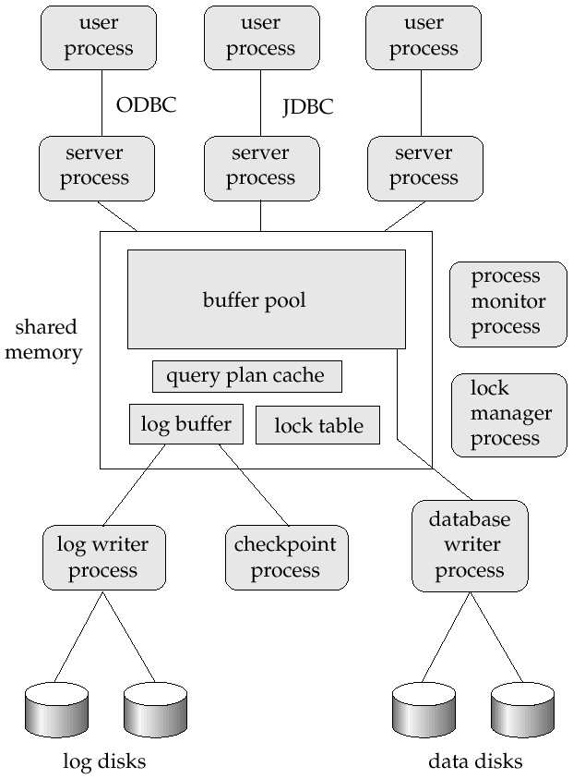
Transaction System Processes (Cont.)

Slide 11
Transaction System Processes (Cont.)
Shared memory contains shared data
  Buffer pool
  Lock table
  Log buffer
  Cached query plans (reused if same query submitted again)
All database processes can access shared memory
To ensure that no two processes are accessing the same data structure at the same time, databases systems implement mutual exclusion using either
  Operating system semaphores
  Atomic instructions such as test-and-set

Slide 12
Transaction System Processes (Cont.)
To avoid overhead of interprocess communication for lock request/grant, each database process operates directly on the lock table data structure (Section 16.1.4) instead of sending requests to lock manager process
  Mutual exclusion ensured on the lock table using semaphores, or more commonly, atomic instructions
  If a lock can be obtained, the lock table is updated directly in shared memory
  If a lock cannot be immediately obtained, a lock request is noted in the lock table and the process (or thread) then waits for lock to be granted
  When a lock is released, releasing process updates lock table to record release of lock, as well as grant of lock to waiting requests (if any)
  Process/thread waiting for lock may either:
    Continually scan lock table to check for lock grant, or
    Use operating system semaphore mechanism to wait on a semaphore.
      Semaphore identifier is recorded in the lock table
      When a lock is granted, the releasing process signals the
      semaphore to tell the waiting process/thread to proceed
Lock manager process still used for deadlock detection

Slide 13
Data Servers
Used in LANs, where there is a very high speed connection between the clients and the server, the client machines are comparable in processing power to the server machine, and the tasks to be executed are compute intensive.
Ship data to client machines where processing is performed, and then ship results back to the server machine.
This architecture requires full back-end functionality at the clients.
Used in many object-oriented database systems
Issues:
  Page-Shipping versus Item-Shipping
  Locking
  Data Caching
  Lock Caching

Slide 14
Data Servers (Cont.)
Page-Shipping versus Item-Shipping
  Smaller unit of shipping ⇒ more messages
  Worth prefetching related items along with requested item
  Page shipping can be thought of as a form of prefetching
Locking
  Overhead of requesting and getting locks from server is high due to message delays
  Can grant locks on requested and prefetched items; with page shipping, transaction is granted lock on whole page.
  Locks on a prefetched item can be P{called back} by the server, and returned by client transaction if the prefetched item has not been used.
  Locks on the page can be deescalated to locks on items in the page when there are lock conflicts. Locks on unused items can then be returned to server.

Slide 15
Data Servers (Cont.)
Data Caching
  Data can be cached at client even in between transactions
  But check that data is up-to-date before it is used (cache coherency)
  Check can be done when requesting lock on data item
Lock Caching
  Locks can be retained by client system even in between transactions
  Transactions can acquire cached locks locally, without contacting server
  Server calls back locks from clients when it receives conflicting lock request. Client returns lock once no local transaction is using it.
  Similar to deescalation, but across transactions.

Slide 16
Parallel Systems
Parallel database systems consist of multiple processors and multiple disks connected by a fast interconnection network.
A coarse-grain parallel machine consists of a small number of powerful processors
A massively parallel or fine grain parallel machine utilizes thousands of smaller processors.
Two main performance measures:
  throughput --- the number of tasks that can be completed in a given time interval
  response time --- the amount of time it takes to complete a single task from the time it is submitted

Slide 17
Speed-Up and Scale-Up
Speedup: a fixed-sized problem executing on a small system is given to a system which is N-times larger.
  Measured by:
  speedup = small system elapsed time
  large system elapsed time
  Speedup is linear if equation equals N.
Scaleup: increase the size of both the problem and the system
  N-times larger system used to perform N-times larger job
  Measured by:
  scaleup = small system small problem elapsed time
  big system big problem elapsed time
  Scale up is linear if equation equals 1.

Slide 18
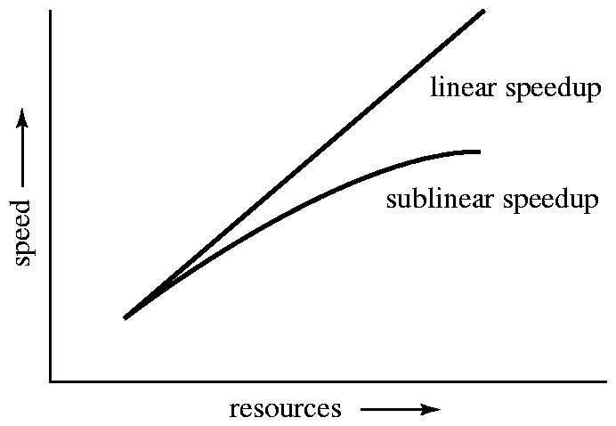
Speedup
Speedup

Slide 19
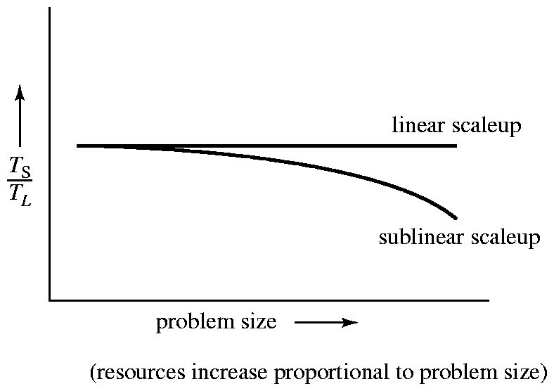
Scaleup
Scaleup

Slide 20
Batch and Transaction Scaleup
Batch scaleup:
  A single large job; typical of most database queries and scientific simulation.
  Use an N-times larger computer on N-times larger problem.
Transaction scaleup:
  Numerous small queries submitted by independent users to a shared database; typical transaction processing and timesharing systems.
  N-times as many users submitting requests (hence, N-times as many requests) to an N-times larger database, on an N-times larger computer.
  Well-suited to parallel execution.

Slide 21
Factors Limiting Speedup and Scaleup
Speedup and scaleup are often sublinear due to:
Startup costs: Cost of starting up multiple processes may dominate computation time, if the degree of parallelism is high.
Interference: Processes accessing shared resources (e.g.,system bus, disks, or locks) compete with each other, thus spending time waiting on other processes, rather than performing useful work.
Skew: Increasing the degree of parallelism increases the variance in service times of parallely executing tasks. Overall execution time determined by slowest of parallely executing tasks.

Slide 22
Interconnection Network Architectures
Bus. System components send data on and receive data from a single communication bus;
  Does not scale well with increasing parallelism.
Mesh. Components are arranged as nodes in a grid, and each component is connected to all adjacent components
  Communication links grow with growing number of components, and so scales better.
  But may require 2√n hops to send message to a node (or √n with wraparound connections at edge of grid).
Hypercube. Components are numbered in binary; components are connected to one another if their binary representations differ in exactly one bit.
  n components are connected to log(n) other components and can reach each other via at most log(n) links; reduces communication delays.

Slide 23
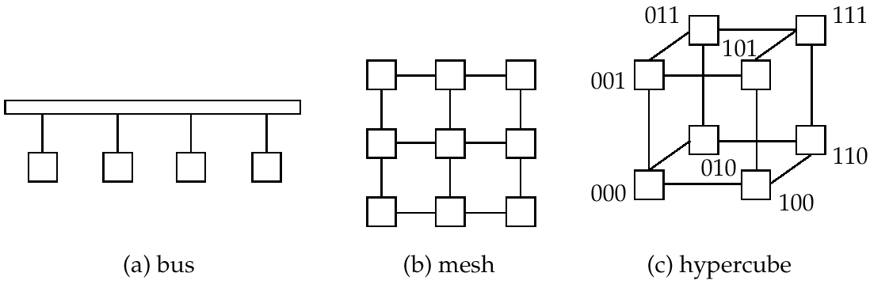
Interconnection Architectures

Slide 24
Parallel Database Architectures
Shared memory -- processors share a common memory
Shared disk -- processors share a common disk
Shared nothing -- processors share neither a common memory nor common disk
Hierarchical -- hybrid of the above architectures

Slide 25
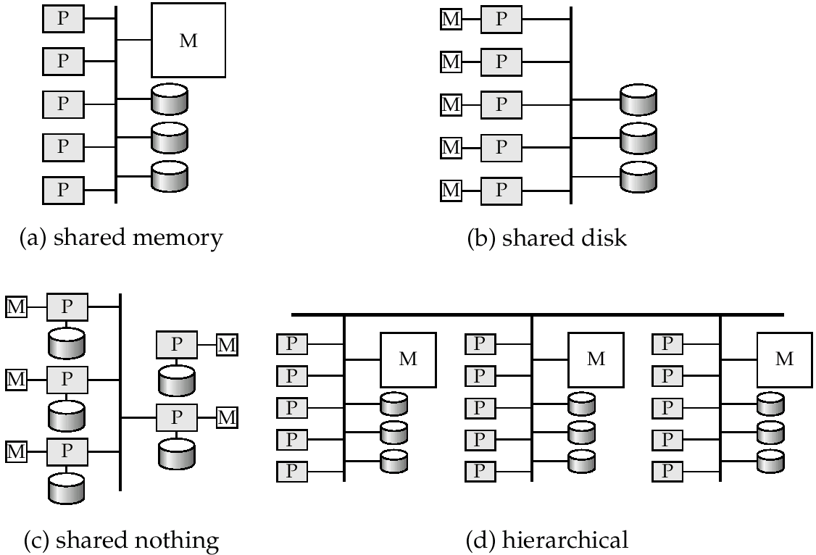
Parallel Database Architectures

Slide 26
Shared Memory
Processors and disks have access to a common memory, typically via a bus or through an interconnection network.
Extremely efficient communication between processors — data in shared memory can be accessed by any processor without having to move it using software.
Downside – architecture is not scalable beyond 32 or 64 processors since the bus or the interconnection network becomes a bottleneck
Widely used for lower degrees of parallelism (4 to 8).

Slide 27
Shared Disk
All processors can directly access all disks via an interconnection network, but the processors have private memories.
  The memory bus is not a bottleneck
  Architecture provides a degree of fault-tolerance — if a processor fails, the other processors can take over its tasks since the database is resident on disks that are accessible from all processors.
Examples: IBM Sysplex and DEC clusters (now part of Compaq) running Rdb (now Oracle Rdb) were early commercial users
Downside: bottleneck now occurs at interconnection to the disk subsystem.
Shared-disk systems can scale to a somewhat larger number of processors, but communication between processors is slower.

Slide 28
Shared Nothing
Node consists of a processor, memory, and one or more disks. Processors at one node communicate with another processor at another node using an interconnection network. A node functions as the server for the data on the disk or disks the node owns.
Examples: Teradata, Tandem, Oracle-n CUBE
Data accessed from local disks (and local memory accesses) do not pass through interconnection network, thereby minimizing the interference of resource sharing.
Shared-nothing multiprocessors can be scaled up to thousands of processors without interference.
Main drawback: cost of communication and non-local disk access; sending data involves software interaction at both ends.

Slide 29
Hierarchical
Combines characteristics of shared-memory, shared-disk, and shared-nothing architectures.
Top level is a shared-nothing architecture – nodes connected by an interconnection network, and do not share disks or memory with each other.
Each node of the system could be a shared-memory system with a few processors.
Alternatively, each node could be a shared-disk system, and each of the systems sharing a set of disks could be a shared-memory system.
Reduce the complexity of programming such systems by distributed virtual-memory architectures
  Also called non-uniform memory architecture (NUMA)

Slide 30
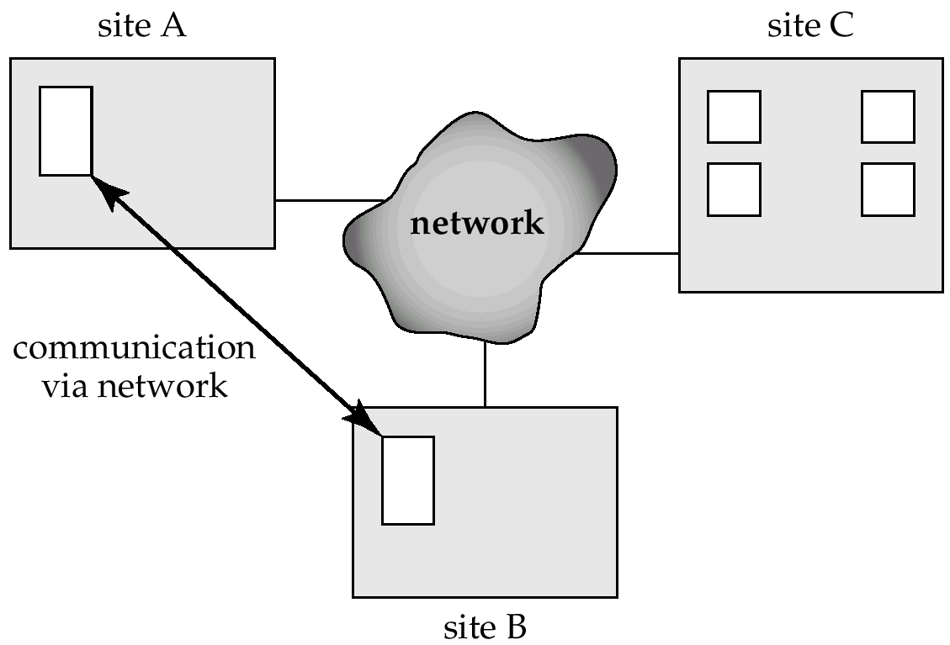
Distributed Systems
Data spread over multiple machines (also referred to as sites or nodes.
Network interconnects the machines
Data shared by users on multiple machines

Slide 31
Distributed Databases
Homogeneous distributed databases
  Same software/schema on all sites, data may be partitioned among sites
  Goal: provide a view of a single database, hiding details of distribution
Heterogeneous distributed databases
  Different software/schema on different sites
  Goal: integrate existing databases to provide useful functionality
Differentiate between local and global transactions
  A local transaction accesses data in the single site at which the transaction was initiated.
  A global transaction either accesses data in a site different from the one at which the transaction was initiated or accesses data in several different sites.

Slide 32
Trade-offs in Distributed Systems
Sharing data – users at one site able to access the data residing at some other sites.
Autonomy – each site is able to retain a degree of control over data stored locally.
Higher system availability through redundancy — data can be replicated at remote sites, and system can function even if a site fails.
Disadvantage: added complexity required to ensure proper coordination among sites.
  Software development cost.
  Greater potential for bugs.
  Increased processing overhead.

Slide 33
Implementation Issues for Distributed Databases
Atomicity needed even for transactions that update data at multiple site
  Transaction cannot be committed at one site and aborted at another
The two-phase commit protocol (2PC) used to ensure atomicity
  Basic idea: each site executes transaction till just before commit, and the leaves final decision to a coordinator
  Each site must follow decision of coordinator: even if there is a failure while waiting for coordinators decision
    To do so, updates of transaction are logged to stable storage and transaction is recorded as “waiting”
  More details in Sectin 19.4.1
2PC is not always appropriate: other transaction models based on persistent messaging, and workflows, are also used
Distributed concurrency control (and deadlock detection) required
Replication of data items required for improving data availability
Details of above in Chapter 19

Slide 34
Network Types
Local-area networks (LANs) – composed of processors that are distributed over small geographical areas, such as a single building or a few adjacent buildings.
Wide-area networks (WANs) – composed of processors distributed over a large geographical area.
Discontinuous connection – WANs, such as those based on periodic dial-up (using, e.g., UUCP), that are connected only for part of the time.
Continuous connection – WANs, such as the Internet, where hosts are connected to the network at all times.

Slide 35
Networks Types (Cont.)
WANs with continuous connection are needed for implementing distributed database systems
Groupware applications such as Lotus notes can work on WANs with discontinuous connection:
  Data is replicated.
  Updates are propagated to replicas periodically.
  No global locking is possible, and copies of data may be independently updated.
  Non-serializable executions can thus result. Conflicting updates may have to be detected, and resolved in an application dependent manner.

Slide 36
End of Chapter

Slide 37
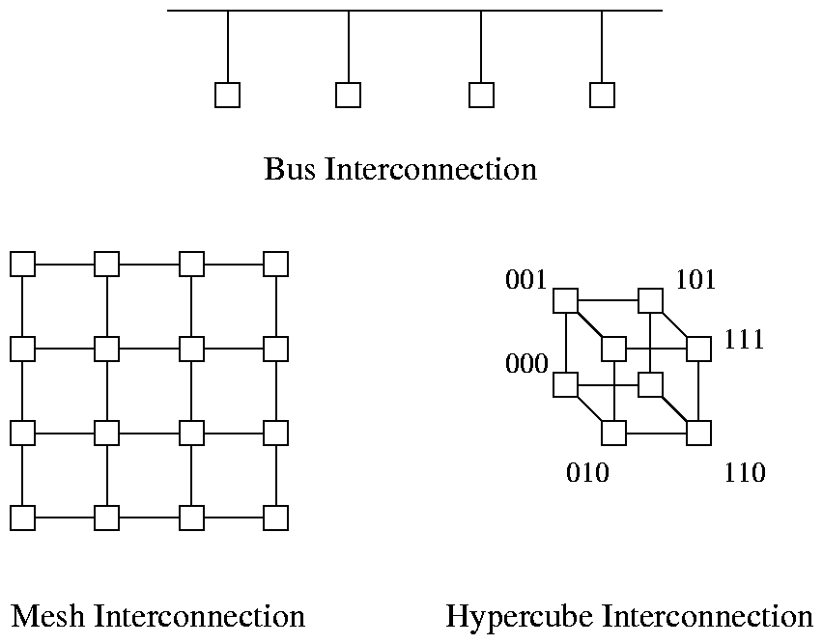
Interconnection Networks

Slide 38
A Distributed System

Slide 39
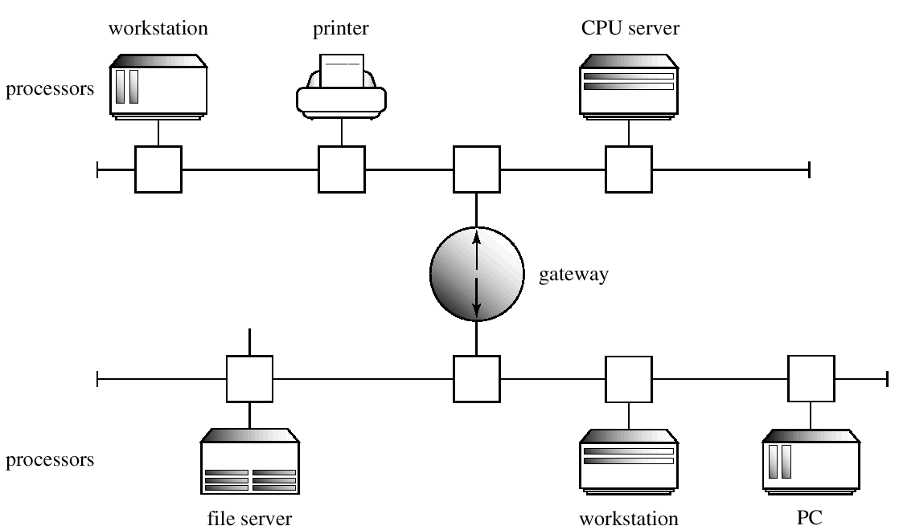
Local-Area Network

